Slide 1
ORACLES Forecast Briefing (Aerosols)
14 September 2016

Slide 2
The Aerosol Week

Slide 3
Thursday 15 September 2017
TBD Flight Day

Slide 4
Clouds & Aerosols - Thu 2016-09-15 9Z

Slide 5
GEOS-5 AOD on Thursday 2016-09-15 12Z

Slide 6
Dust
OC

Slide 7
72 h Forecast
96 h Forecast

Slide 8
GEOS-5
WRF

Slide 9
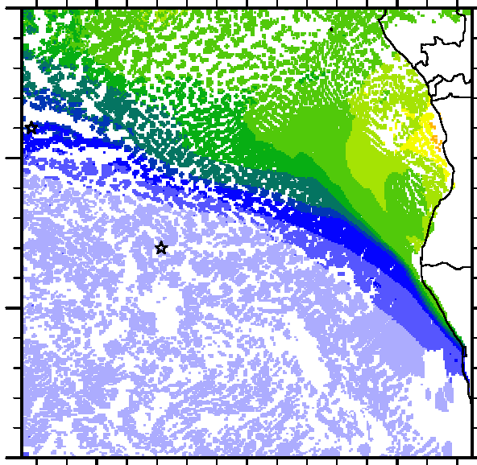
GEOS-5
WRF

Slide 10
GEOS-5
WRF

Slide 11
Friday 16 September 2017
No Flight

Slide 12
Clouds & Aerosols - Fri 2016-09-16 9Z

Slide 13
72 h Forecast
Thursday
Friday

Slide 14
Thursday
Friday

Slide 15
Thursday
Dust
Friday
OC

Slide 16
Smoke Age Distribution: 600 hPa
Thursday
Friday

Slide 17
WRF Extinction: NW-SE
Thursday
Friday

Slide 18
Smoke Age Distribution: NW-SE
Thursday
Friday

Slide 19
WRF Extinction: W-E at 15S
Thursday
Friday

Slide 20
Smoke Mean Age: W-E at 15S
Thursday
Friday

